Slide 1


INCUBATION
-Practical Guidance-

Slide 2

COMPANY
Founded in the early 90s, Equitec is the result of the experience distributing cooling and freezing equipment in the research & health market for more than 20 years.
We are leaders in the Iberian Peninsula, manufacturing cooling and climatic equipment, for the research laboratory, education and health.
We manufacture refrigerators and freezers up to -86ºC: for Blood banks, Hospitals, Universities and Control quality.
Chambers for stability tests, plants, tissues, insects and materials from -40ºC to + 60ºC; with humidity and controlled light, both for the industry and research.
We distribute our products worldwide, through specialized distributors in each region or country

Slide 3
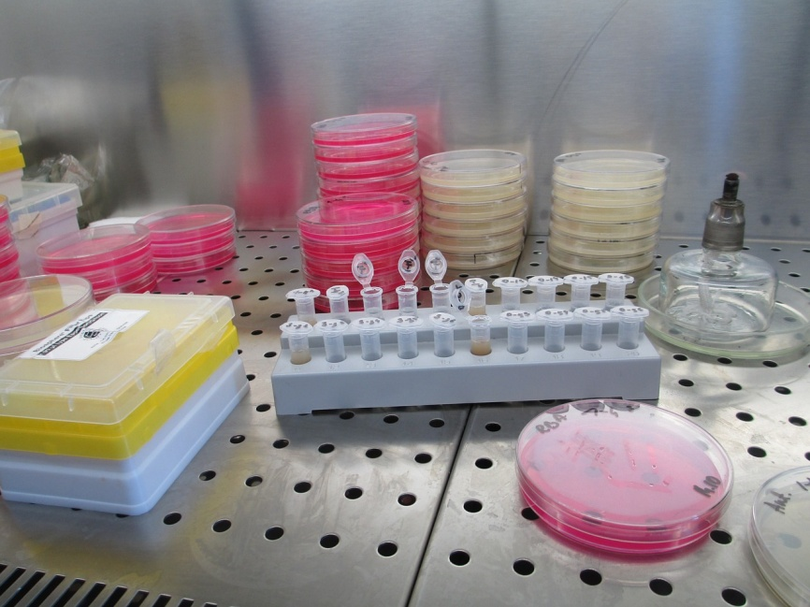
INCUBATOR TYPES
There are two types of equipment for incubation, static or natural convection and forced air.
The incubators of forced air differ essentially in a greater speed to reach the conditions of work, as well as in the stability and greater uniformity within the own team.
Static incubators are usually smaller volume, due to their constructive limitations.
Its applications are diverse as: food industry, pharmacy, biological culture, etc.

Slide 4
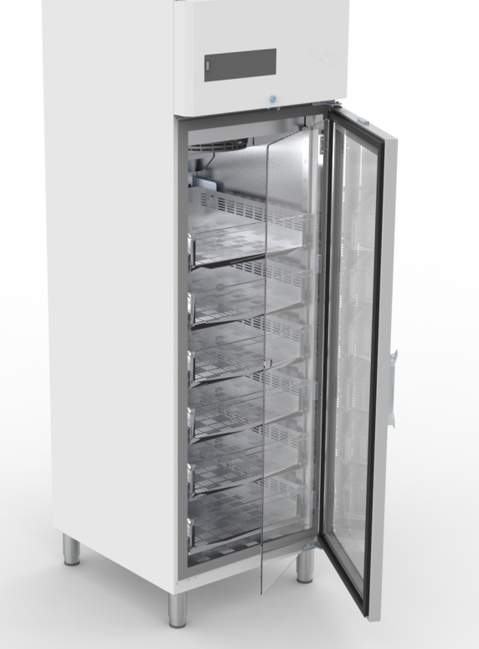
INCUBATOR TYPES
The forced air incubators are based on the circulation of the air by means of an internal fan that guarantees the movement of the air and a uniformity and precise control over the temperatures., In this way it offers ideal conditions for the incubation of any laboratory product.
The heating and cooling system will maintain a homogeneous and stable distribution of heat at all points of the chamber, as well as rapid heating and maintenance of internal conditions.
The system will be completed with a temperature controller using PID parameters, with an excellent heating control over a wide range of temperatures.

Slide 5
INCUBATORS FEATURES
Different options of interior and exterior finishes
Interior made of stainless steel AISI 304 , optional AISI 316.
Exterior, steel coated with epoxy. , optional AISI 304
Optional: internal glass door with independent lock
PID microprocessor, to control all parameters, with fuzzy logic,
to ensure a high temperature stability inside of the chamber.
Temperature range from +4ºC to +55ºC, .
Variable humidity ranges depending on the application.
Forced air refrigeration system
Probe control with a precision of 0,1ºC.
Homogeneity of +/- 1.0ºC inside of the chamber at 37ºC.
Stability of +/- 0.4ºC inside of the chamber at 37ºC.
Audible and visible alarms
Security thermostat.
Optional Lights for samples with photoperiod

Slide 6
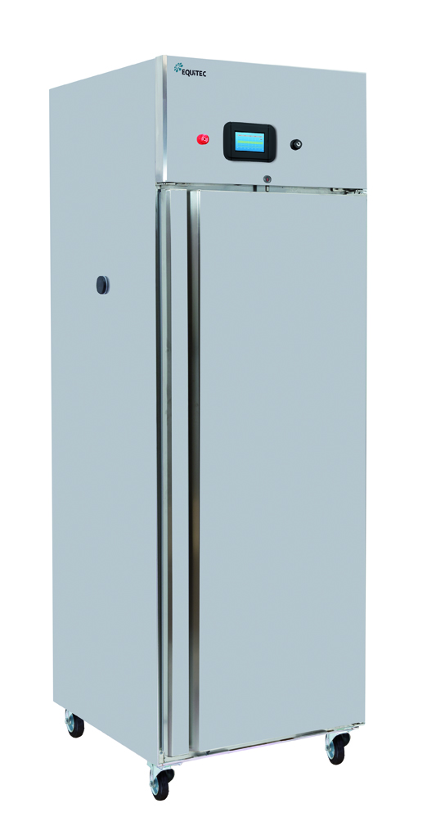
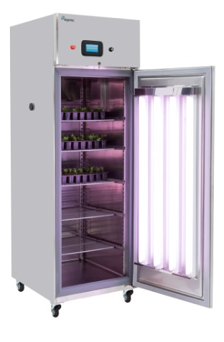
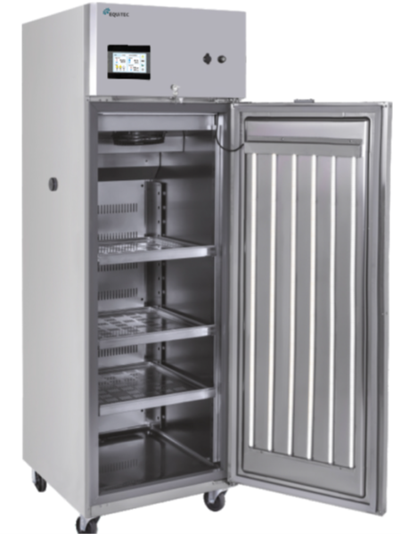
SPECIAL LIGHTING
In some applications, it will be necessary to use an auxiliary lighting system, to be able to condition the samples under temperature, humidity and light conditions.
In this case, there are different types of light to be able to introduce inside the camera as fluorescent tubes or low consumption LEDs.
Our experience in plant growth chambers will be help to our clients to select the most suitable option for their application.

Slide 7
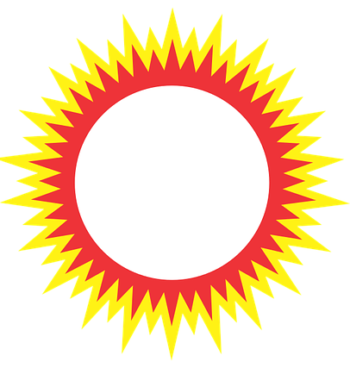
TEMPERATURE RANGE
Each sample will have an optimal incubation temperature depending on the type of incubation that is to be developed. Although there are incubators with a greater range, it does not mean that they are the most suitable, because this type of equipment is oversized and therefore the work of the equipment decrease and it is not working with the maximum benefit..
Our incubators usually have a wide range, between + 5º C and + 50º C, which will cover most of the client's needs. For other ranges, please contact us.
As optional, our equipment has the possibility of controlling the relative humidity of the environment, to improve the control conditions inside the incubator.
Select your incubator with the most suitable range for your global needs.

Slide 8
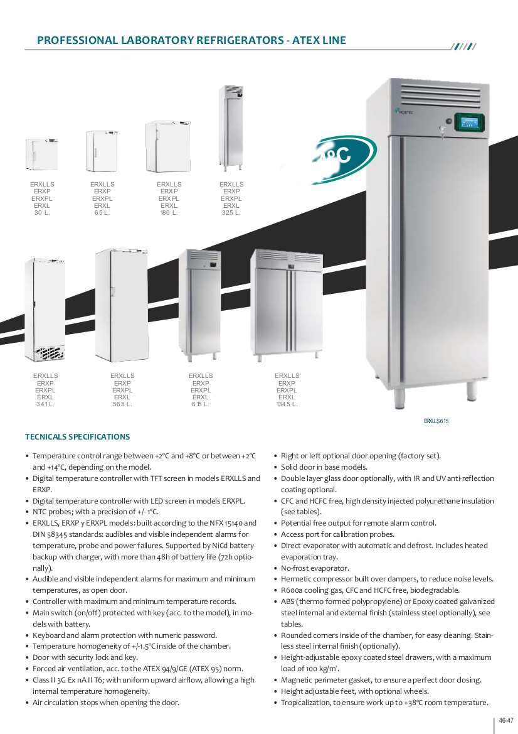
VOLUMEN
There are different possibilities of volumes to select an incubator, for a large number of samples as well for a small number of samples. Meanwhile static incubators usually have a small volume and forced air incubators allow larger volumes, also volumes of up to 1300 liters can be available.
The volume of the equipment will be indicated by the number of samples that will be introduced inside of the equipment.
Select an optimal volume will help reduce energy consumption and reduce the cost of installing the equipment.

Slide 9
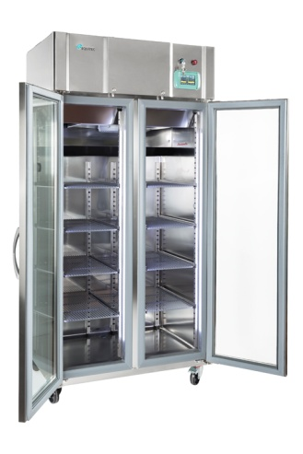
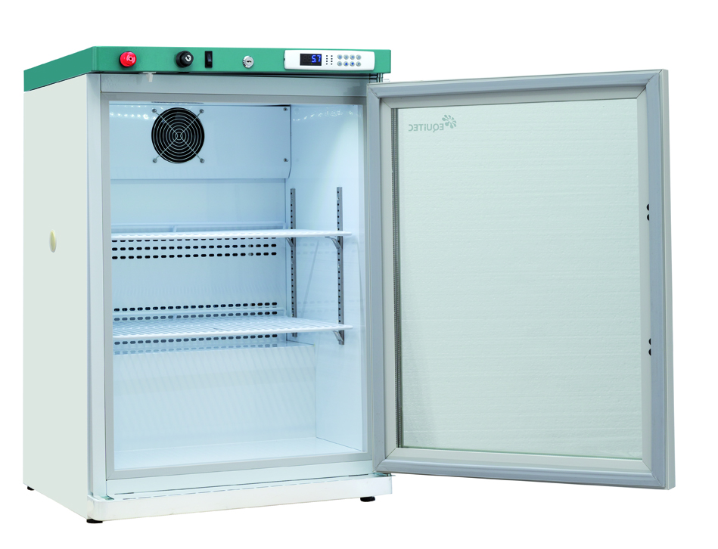
INTERIOR FINISHES
Interior finishes can affect the product depending on the sensitivity of the product. If the product may be susceptible to contamination, select an inert option, such as stainless steel. In general cases you can choose other interior finishes such as galvanized steel with epoxy paint or ABS finish.
We have different alternatives for interior finishes depending on the type of product to store.
Choose an interior finish that can not affect the stored products.
ABS
FINISH
STAINLESS STEEL
FINISH

Slide 10
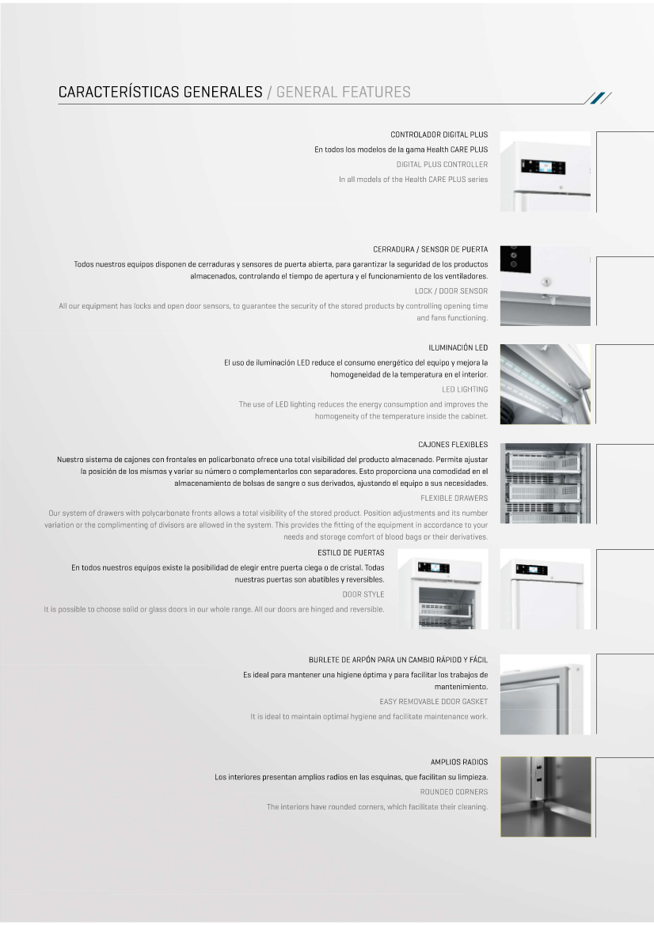
DOORS
Doors are important elements in incubators. They must allow access to the entire interior of the incubator and make a perfect seal when closing, by magnetic strips.
It is recommended that you have a self-closing device, which keeps the door open from an angle, and below that angle the doors are automatically closed to avoid losses of the interior conditions and the extraction / placement of samples quickly.
A door lock security key prevents unwelcome manipulation of samples.
Select a door that allows access to the entire interior with self-locking system and lock key

Slide 11
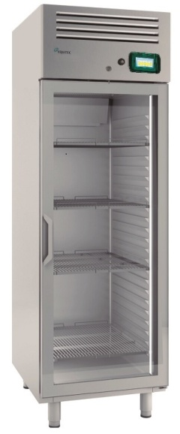
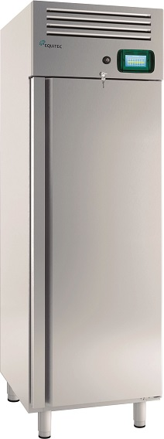
CRYSTAL
There are two possibilities of glass: internal or in the door. This permit the visualization of the samples inside of the camera, besides being able to avoid the possibility of contamination when opening the doors to observe them.
If the samples are photo-sensitive, this type of option is not recommended, or if the equipment is located in an area influenced by direct sunlight or another source of light that may affect the samples.
Select the door glass option depending on the final location of the equipment and the light sensitivity of the samples.

Slide 12
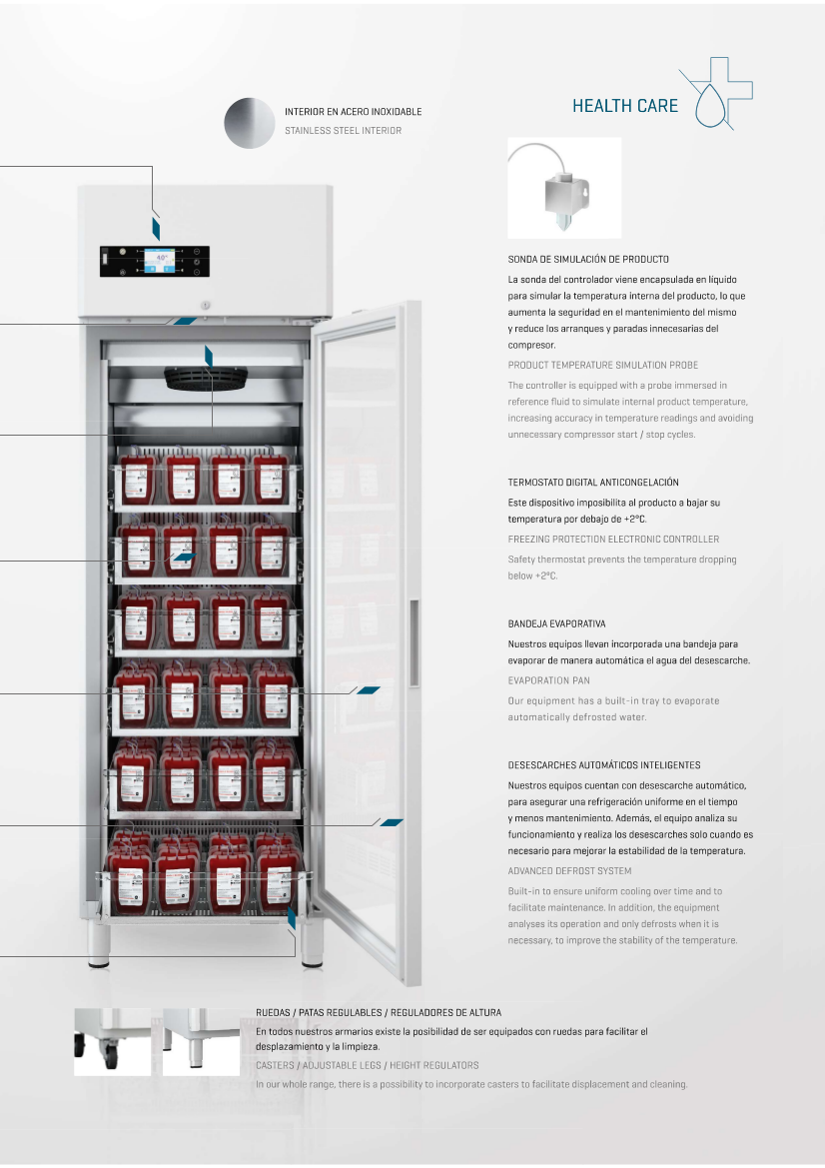
CASTORS
Before select the option of legs or wheels, it is necessary study the area where you want to place the incubator to analyze if the area is level or has a slight drop.
Keep in mind that the castors may be a comfortable option to move the incubator, but these castors can not be leveled, however the legs can be adjusted individually, so depending on the floor where you are going to place the equipment you can the option of adjustable legs in height, may be the best option.
Analyze if the floor where you are going to place the equipment has unevenness, to select the option of wheels or legs.

Slide 13
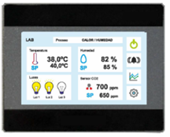
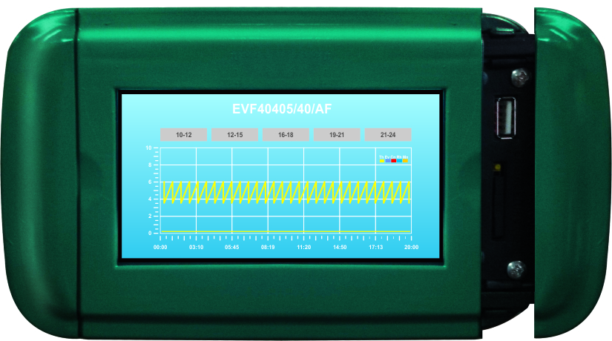
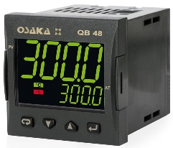
CONTROL
We have many control varieties to offer in our products that it is a strong point for our customers
Depending on the application and features you are looking for, we can offer up to 4 different types of controls.
A great advantage for the client, sometimes the customer pays a higher cost for a control with too many functions that he will not use or too complex, that makes him waste time learning unnecessary functions.
Select the control that best suits your needs.

Slide 14
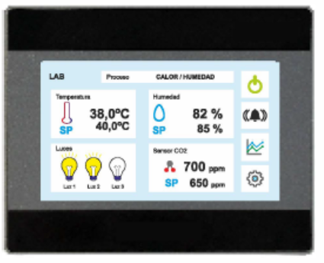
CONTROL
4100 SERIE
TFT touch screen 7,0” or 4,3”
-3 Audible and visible alarms
-Remote alarm
USB.
Ethernet
- Battery
Different languages.
Datalogger
Graphic interface.
Password.
2500 SERIE
-Easy and intuitive.
2 displays 4 digits MULTI Color
Password.
Visual alarm
Acustic alarm
- Test alarm control
4000 SERIE
TFT touch screen 4,3”
-3 Audible and visible alarms
-Remote alarm
USB.
Ethernet
- Battery
Different languages.
Datalogger
Graphic interface.
Password.
2000 SERIE
-Easy and intuitive.
2 displays 4 digits MULTI Color
Password.
Visual alarm
Acustic alarm
- Test alarm control

Slide 15
OUR SOLUTIONS

Slide 16
ERI - ERIS
Multi-sectorial products, with the possibility of applications in laboratories to guarantee its users above all, safety and thermal stability.
With interior and exterior finishes in stainless steel and different control options. With many volume from 325 to 1240 liters capacity.
As standard it has different levels of shelves to be able to test numerous samples in parallel.
It has the possibility of two types of standard controllers, the controller 4000 and the controller 2500, depending on the needs of the client.
Humidity control as optional.

Slide 17
ERI BOD
Models with interior finishes in galvanized steel
plasticized white or ABS (plastic), depending on
the selected model. Outward they have a finish
in plasticized galvanized steel.
The volumes of this series range from 65 liters to
565 liters capacity, ideal for small or medium
sample numbers.
The standard controls associated with this series are
the 2000 series and the 1000 series.
Humidity control as optional.

Slide 18
ERI – ERIS
CHROMAT LINE
FOR APPLICATIONS WITH CHROMATOGRAPHERS,
LARGE SIZE AGITATORS
OR INSTRUMENT THERMOSTATIZATION
With interior and exterior finishes in stainless steel and different control options. With many volume from 325 to 1240 liters capacity.
Humidity control as optional.
Tray for supporting agitators, chromatographs
or other equipment with movement or heavy weight

Slide 19
ERI – ERIS CHROMAT LINE

Slide 20
ERI – ERIS
DPH LINE
DROSOPHILA AND ENTHOMOLOGY CHAMBERS
DPH 4000 LINE AND DPH INOX LINE
VERTICAL FORCED AIR MODELS
With many volume from 325 to 1240 liters capacity.
Interior made of stainless steel AISI 304 , optional AISI 316.
Exterior, steel coated with epoxy. , optional AISI 304
Humidity control as optional.
Optional with Photo-period

Slide 21


